Slide 1


Slide 2

OPPORTUNITY

Slide 3
Opportunity
The Power of Mobile Games
  Of top 10 digital downloads for games in 2015:
    6 were mobile games
    2 were monster collector games

Slide 4

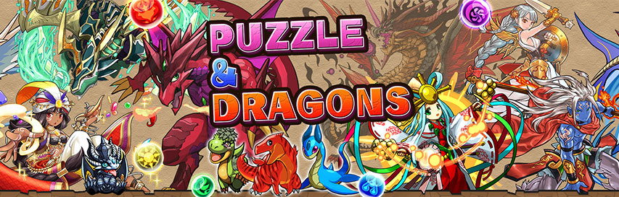
Monster Strike:
$4 million in DAILY revenues
$378 million in just the first fiscal quarter
Puzzle and Dragons:
First mobile game to reach $1 billion in revenues
$4.5 million every day for 2014

Slide 5
Opportunity
Rhythm game genre has been stagnating in the West.
Still a large and vibrant market in Asia
  New titles come up frequently
Tap into the dormant market revitalize it with its twist on the genre

Slide 6
pitch)
“Jukebox Heroes is a bold approach to the rhythm genre. By supplementing addicting rhythm gameplay with the wide appeals of the monster collector genre, we aim to tap into both markets while creating something truly unique to the video game industry.”

Slide 7

KEY FEATURES

Slide 8
Key Features
Over 250 Characters
  Based off real life musical figures
100+ Songs
  Covers as well as original tracks
Addicting rhythm based gameplay
  Tried and true falling notes archetype, with a spin
Real time competitive mode
  One-on-ones and four player free-for-alls

Slide 9

REVENUE OPPORTUNITIES

Slide 10
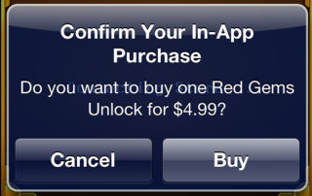
Revenue Opportunities
Jukebox Heroes will utilize a free to play model
  Premium Currency
  Resurrect after song failure
  Gachapon system for obtaining more characters
  Collectible accessories and skins
  Small amounts of Premium Currency will be available through regular gameplay

Slide 11


Slide 12
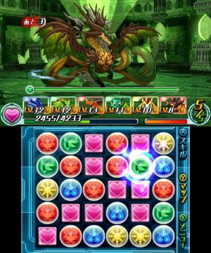
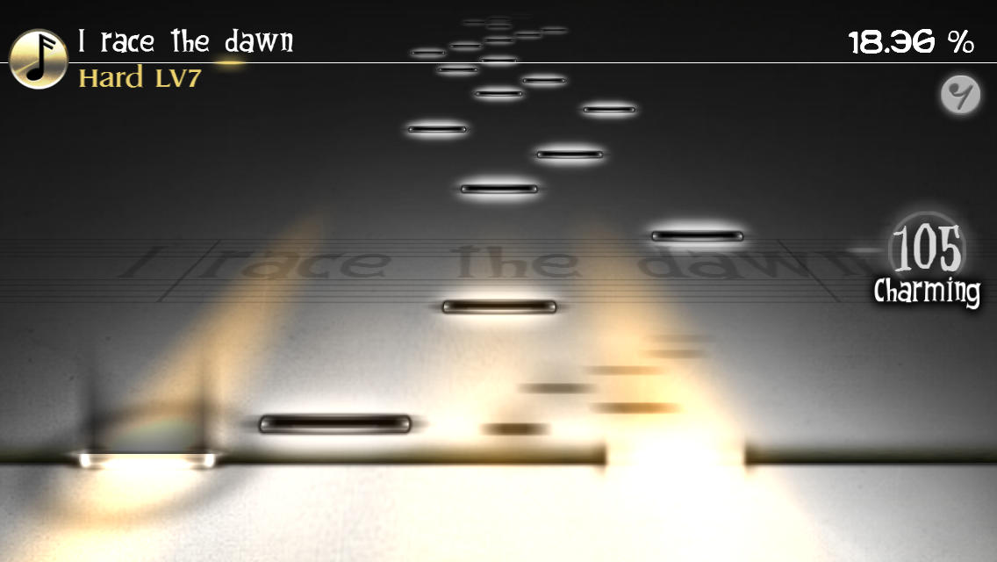
Competitive Landscape
Competition
  Puzzles and Dragons
  Pokémon Go
  Deemo
  Zyon

Slide 13
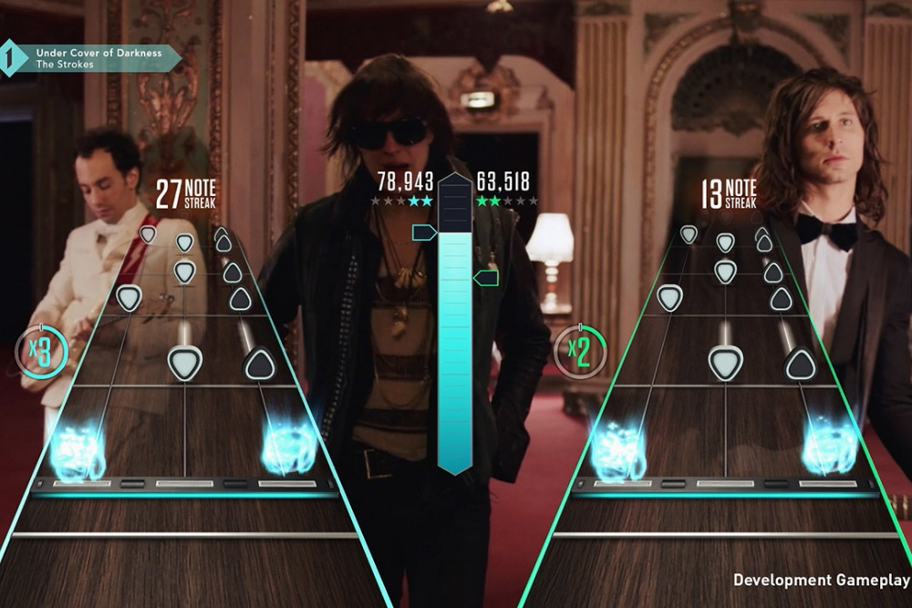
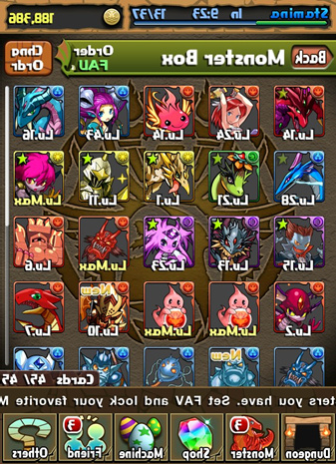
Competitive Landscape
Worried About
  Music/Musician licensing
  Pre-made rhythm games
Advantages
  Unique Monster collector/Rhythm combination
  Real artists featured
  Player Avatar Customization
  Real-time multiplayer
  Players often play multiple games of the same genre

Slide 14


Slide 15
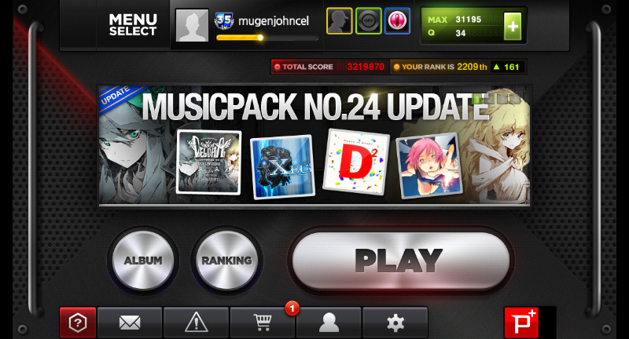
Visual Direction
Environment
  Flashy, techno themes
  Different lights and tracks for each song
Dj Max

Slide 16
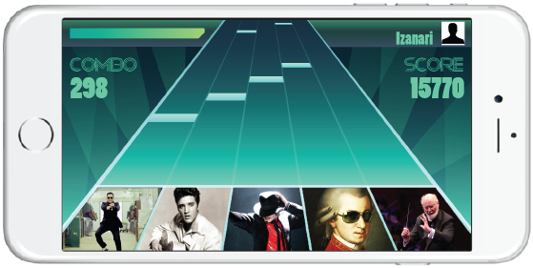
Visual Direction
UI
  Health bar
  Customizable avatar
  Combo number
  Total score

Slide 17
Thank you!

